Slide 1

Course : HTML5
Teacher: Dr. Noura ABOUDI
2025-2026

Slide 2

HTML5 Chapter: Outline
1
HTML: Overview and Versions
The tags
Comments
HTML Example
HTML pages structure
2
3
4
5

Slide 3
HTML5
This chapter aims to acquire has the learner:
Definition of HTML and its purpose
Examples of common tags (headings, paragraphs, links, lists, tables, forms)
Structuring an HTML document
Validating an HTML page and form inputs

Slide 4
HTML : Overview and Versions
What is HTML?
H T M L
Hyper Text Markup Language
Markup language for creating webpages content and structure.
Not a programming language.
Building blocks of the web.
It is a markup language: <tag>Content</tag>.
Contains around 140 tags.

Slide 5






Relevant History of HTML
1991
1995
1997
1999
2008
2015
  HTML 1
HTML 2.0 + JavaScript + Internet Explorer 1
HTML 3.2
HTML 4
HTML 5
HTML 5.3
Notes:
HTML 1.0Created by Tim Berners-Lee, foundation of the World Wide Web.🌐 (Globe / Web origin)
1995HTML 2.0 + JavaScript + Internet Explorer 1Start of interactive and dynamic web pages.⚙️ (Browser + script evolution)
1997HTML 3.2Introduced tables, applets, and better layout control.📄 (Page layout / structure)
1999HTML 4.01Added CSS support, JavaScript, and accessibility features.🎨 (Style / CSS integration)
2008HTML5 (Draft)Major evolution — multimedia, forms, semantic tags.🎬 (Video & multimedia)
2014HTML5 (Official)Became the standard for modern, responsive web development.🚀 (Modern web / launch)

Slide 6






HTML Editors and Browsers
What We Need to Start?
Web Browser:
Text Editor:

Slide 7
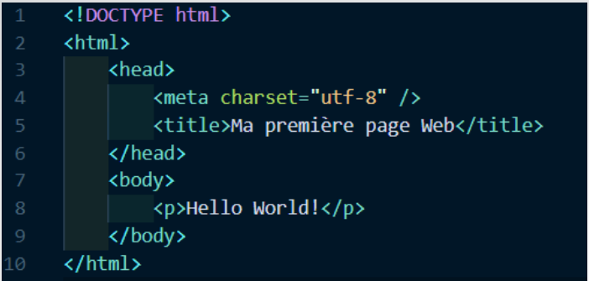
HTML : Example
Files must end with the .html extension
Does NOT need a server
Runs in a web browser(Chrome, Firefox, etc).
index.html is the root/home page of a website.
File
index.html

Slide 8
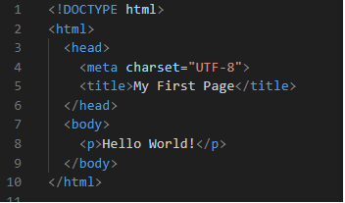
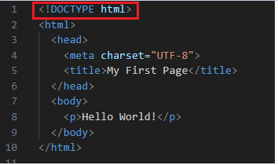
HTML Document Structure
<!DOCTYPE html>:
<!DOCTYPE html> is a declaration (not a tag) that appears at the top of every HTML5 document.
It tells the browser that the page uses HTML5 syntax and follows the HTML5 standard.

Slide 9
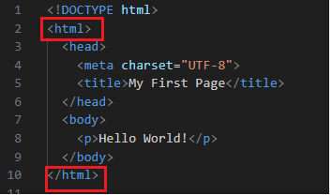
HTML Document Structure
<html></html>
is the root element of an HTML document.
Its presence is required in every page.
It contains all the content of the page (except <!DOCTYPE html>).

Slide 10
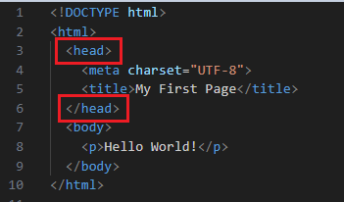
HTML Document Structure : header
<head></head>
Contains page info not shown to users.
Its presence is required in every page.
Common content:
  Meta tags (charset, description, author, viewport)
  Page title
  CSS and JS links
It helps browsers, search engines, and external tools understand the page.→Good metadata helps your page appear higher in search results and with a clearer description.

Slide 11
HTML Document Structure : header
<meta>
Provides metadata ( information) about the page for browsers, search engines, and external tools.
Placed inside <head> and not visible on the page.
Tag | Purpose | Example
<meta charset="UTF-8"> | Defines character encoding | <meta charset="UTF-8">
<meta name="author" content="John Doe"> | Page author | <meta name="author" content=“Leo">
<meta name="keywords" content="HTML5, CSS, JS"> | SEO keywords | <meta name="keywords" content="HTML5, CSS, JS">
<meta name="description" content="HTML5 basic structure"> | SEO page description | <meta name="description" content="HTML5 basic structure">

Slide 12
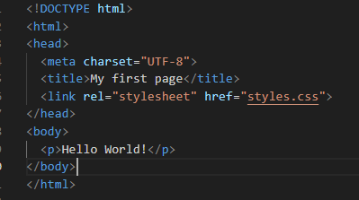
HTML Document Structure : header
<link>
Connects an external CSS file to an HTML document.
Inside the <head> section
Attributes :
rel="stylesheet" → defines relationship type.
href="style.css" → specifies the path to the CSS file.

Slide 13
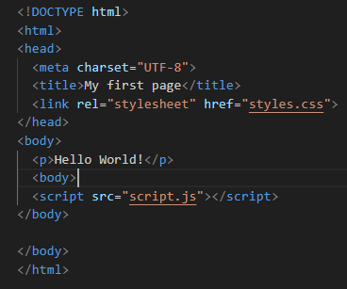
HTML Document Structure
<script>
Links a JavaScript file to add interactivity to a web page.
Usually before </body> to ensure the page loads first.
src="script.js" → specifies the path to the JavaScript file.

Slide 14
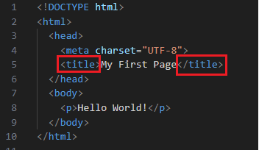
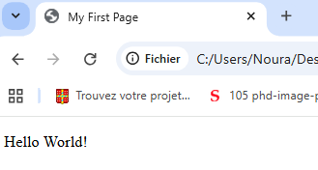
HTML Document Structure : header
<title></title>
Defines the title of the web page.
Appears in the browser tab and search engine results.
Must be placed inside the <head> element.

Slide 15
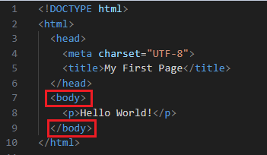
HTML Document Structure : body
<body></body>
Contains all the content visible to users on the web page.
Must be present in every HTML document.
Typical content: headings, paragraphs, images, links, lists, forms, etc.

Slide 16
Structure of HTML Tag: Main components
Element
Element name
Content
<p> | Hello World! | </p>
Opening tag
Closing tag

Slide 17
Structure of HTML Tag
Line Break
Image
Horizontal Rule
<br>
<img>
<hr>
Only opening tag
Only opening tag
Only opening tag

Slide 18
<img> Tag
Used to display images on a webpage.
Not a container tag → does not have a closing tag
Common attributes:
src → path to the image file
alt → text shown if image cannot be displayed (important for accessibility and SEO)
width / height → size of the image
Browsers support common image formats such as JPEG, GIF, PNG, SVG, and BMP.
Exemple: <img src="cat.jpg" alt="A cute cat" width="150px" height="100px">
Notes:
<dl> is used for a list of terms and descriptions. Each term uses <dt> (description term) and each description uses <dd> (description details).

Slide 19
Tags : Attributes
Examples : <a> tag with attributes
<a href="https://horizon-university.tn target="_blank">Horizon School </a>
Tags : <img>,<a>
Attributes: src, alt, width, href, target
Values: cat.jpg, A cute cat, 300, https://horizon-university.tn , _blank

Slide 20
Tag: Attribute
No space allowed
Must have space
No space allowed
Value in quotes
<p id = "myId" > </p>
Attribute
name
Attribute
value

Slide 21
Tags : Attributes
An attributes is used to:
Provide additional details about an element.
Define and change the element behavior and formatting.
Change the appearance of an element.

Slide 22
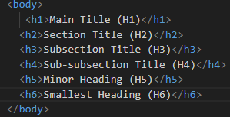
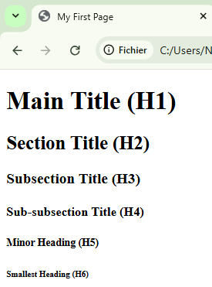
Text Formatting & Basic Tags : headings
HTML provides 6 levels of headings: <h1> to <h6>.
By default, each heading adds space above and below (empty line).
Usually, 3–4 levels are enough for clear page structure.
Notes:
Note: This is different from the <title> tag in <head>, which sets the page title shown in the browser tab, not visible in the page content.
<h1> = most important, largest <h6> = least important, smallest

Slide 23
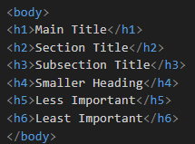
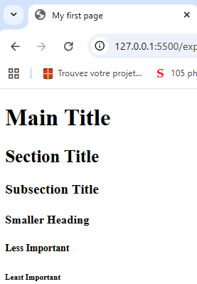
Tags : Title
HTML provides six levels of headings, from <h1> (most important) to <h6> (least important).
Headings help organize content and improve SEO and readability.
Each heading should reflect the structure of the page.

Slide 24
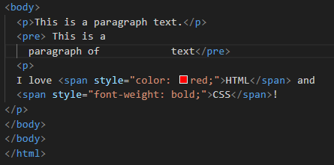
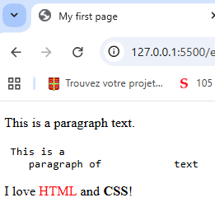
Text Formatting & Basic Tags: Paragraph
tag <p>…</p>
Defines a paragraph of text in an HTML page.
Automatically adds spacing above and below (margin).
Helps structure content into clear, readable sections.
Can include inline elements inside <p> : <strong>, <em>, <b>, <i>, <a>, <span>

Slide 25
Formatting
Bold text: <b> or <strong> <b>Bold</b> / <strong>Important</strong>
Italic text: <i> or <em> <i>Italic</i> / <em>Emphasis</em>
Underline text: <u> <u>Underlined</u>
Strikethrough text: <s> or <del> <s>Old</s> / <del>Deleted</del>
Highlighted text : <mark> <mark>Highlighted</mark>
Small text(reduce size) : <small> <small>Small text</small>
Abbreviation :<abr> <abbr title="HyperText Markup Language">HTML</abbr>
Other tags : <strong>, <mark>, <em>, <abbr>, <quote>, <q>, <code>

Slide 26
HTML Comments
HTML Comments:
Comments are notes in your code (not shown in the browser).
Useful for documentation or disabling code temporarily.
Browsers ignore comments during rendering.
are delimited by <!-- and -->
Example : <!-- This is a comment -->

Slide 27
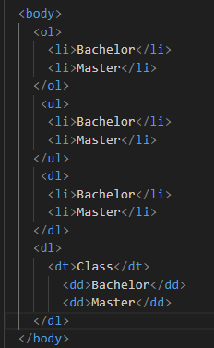
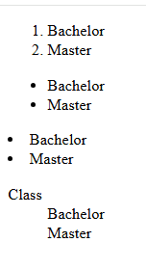
List
List Types
Ordered list : <ol> … </ol>
Unordered list : <ul>….. </ul>
Description list : <dl>… </dl>
List Items
<li> → each item in <ul> or <ol>
Works the same for both ordered and unordered lists
<dt> + <dd> → items in <dl>
<dt> → term (word or title)
<dd> → description
Notes:
<dl> is used for a list of terms and descriptions. Each term uses <dt> (description term) and each description uses <dd> (description details).

Slide 28
<a> Tag : Link
Exemple: <a href="https://www.example.com" target="_blank" title="Visit Example">Visit Example</a>
Types of links:
External page or website : <a href="https://www.google.com">Google</a>
Downloadable file : <a href="file.pdf">Download</a>
Email or phone contact :
<a href="mailto:contact@example.com">Email Us</a>
<a href="tel:+21698765432">Call Us</a>
Link to a section on the same page :
<h1 id="top">Welcome!</h1>
<a href="#top">Go to Top</a>
href → the URL or location the link points to (URL, email, )
  target → where to open the link (_blank, _self, etc.)
  title → additional information shown on hover
Notes:
<dl> is used for a list of terms and descriptions. Each term uses <dt> (description term) and each description uses <dd> (description details).

Slide 29
<a> Tag : Link
<a>…</a> : It is used to create hyperlinks in HTML.
<a href= " Your Link" target= " _blank" > Clickable Text </a>
HTML
Link Paths
The HTML tag used to create links It makes text, images, or buttons clickable(une autre page web, un fichier, …)
where to open the link (_blank, _self, etc.)
The text that will act as the hyperlink
<body>
<p>
Horizon University Website
<a href=" https://horizon-university.tn/fr "> Horizon</a>
</p>
</body>
Lien vers un mail
<a href="mailto:noura.aboudi@horizon-university.tn">Write Email !</a>
Notes:
<dl> is used for a list of terms and descriptions. Each term uses <dt> (description term) and each description uses <dd> (description details).

Slide 30
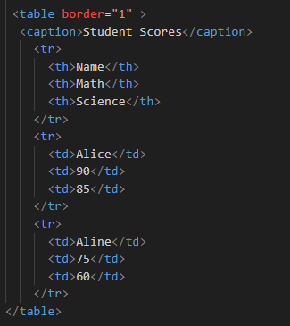
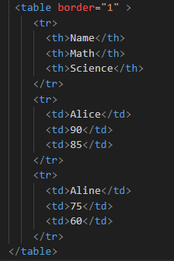
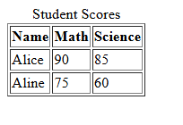
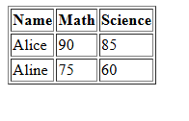
Tag: <table>
<table>…</table> indicates the beginning and the end of a table.
<tr>…</tr> indicates the beginning and the end of a row (line)
The tags <td>…</td> indicate the beginning and the end of a cell of row.
<body>
  <table>
  <tr>
  <td>Ligne 1 – Colonne 1</td>
  <td>Ligne 2 – Colonne 2</td>
  </tr>
  <tr>
  <td>Ligne 2 – Colonne 1</td>
  <td>Ligne 2 – Colonne 2</td>
  </tr>
  </table>
</body>
You can add a header cell: <th> … </th>
Optional border (deprecated in HTML5): <table border="1">

Slide 31
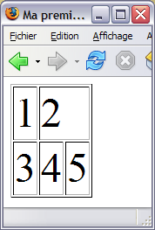
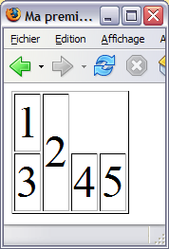
Tags : Table
colspan : is used to merge multiple columns into a single cell. <td colspan="C">
  rowspan is used to merge multiple rows into a single cell. <td rowspan="L">
<table>
<tr> <td>1 <td colspan=2>2
<tr> <td>3 <td>4 <td>5
</table>
<table>
<tr> <td>1 <td rowspan=2>2
<tr> <td>3 <td>4 <td>5
</table>

Slide 32
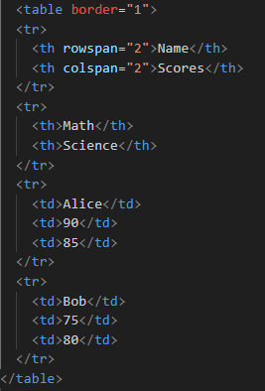
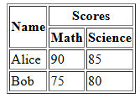
Tags : Table
colspan : is used to merge multiple columns into a single cell. <td colspan="C">
  rowspan : is used to merge multiple rows into a single cell. <td rowspan="L">
<table>
<tr> <td>1 <td colspan=2>2
<tr> <td>3 <td>4 <td>5
</table>
<table>
<tr> <td>1 <td rowspan=2>2
<tr> <td>3 <td>4 <td>5
</table>

Slide 33
<table> Tag
Old HTML Way (deprecated in HTML5)
The border attribute adds a border around the table and cells.
Syntax :<table border="1">

Slide 34
<table> Tag
Table Caption
Use the <caption> tag to add a title to your table.
Placement: immediately after opening <table> or just before it closes.
Improves readability and accessibility.

Slide 35
Merging Table Cells
Horizontal Merge : Columns Merge
Use the colspan attribute to merge multiple columns in a row.
<td colspan= "2">
Vertical Merge : Lines Merge
Use the rowspan attribute to merge multiple rows in a column.
<td rowspan = "2">

Slide 36
Tags : List
List Types
Ordered list : <ol> … </ol>
Unordered list : <ul>….. </ul>
Description list : <dl>… </dl>
List Items
<li> → each item in <ul> or <ol>
Works the same for both ordered and unordered lists
<dt> + <dd> → items in <dl>
<dt> → term (word or title)
<dd> → description
Notes:
<dl> is used for a list of terms and descriptions. Each term uses <dt> (description term) and each description uses <dd> (description details).

Slide 37
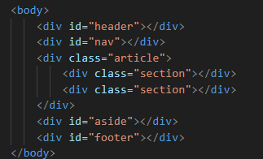
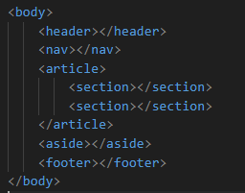
HTML5 Document Structure
  Before
Too many DIVs kill the DIV!
  After

Slide 38
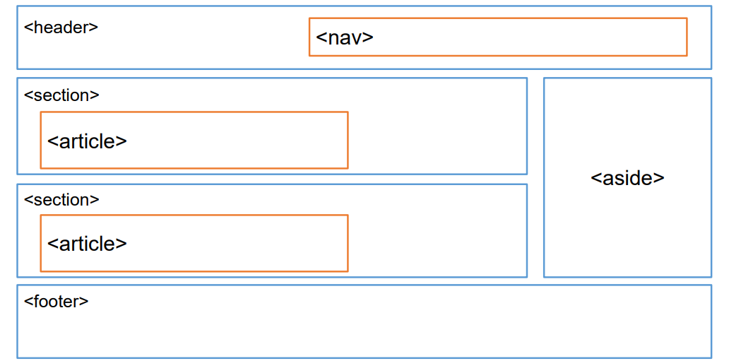
HTML Document Structure

Slide 39
HTML5 Document Structure
Tags | Description
<header> | Represents the introductory section of a webpage. Typically contains the site's logo, navigation menu, and other important branding elements.
<nav> | Defines a navigation section with links to other pages or sections within the website.
<footer> | Represents the footer of a webpage, usually containing copyright information, contact details, and related links.
<section> | Defines a standalone section of content within a webpage, often with a thematic grouping of information.
<aside> | Contains content indirectly related to the main content, such as sidebars, advertisements, or additional info.
<article> | Represents a self-contained piece of content that can be independently distributed or reused, like a blog post, news article, or forum post.
Notes:
https://www.linkedin.com/pulse/html-layout-elements-modern-web-design-pushpendra-kumar/

Slide 40
HTML5 Document Structure : Header
<body>
<header>
<h1>My Website</h1>
<p>Welcome to my website!</p>
</header>
<nav>
<ul>
<li><a href="#">Home</a></li>
<li><a href="#">About</a></li>
<li><a href="#">Services</a></li>
<li><a href="#">Contact</a></li>
</ul>
</nav>
<section>
<article>
<h2>Article Title</h2>
<p>This is the main article content. You can write paragraphs, images, and other information here.</p>
</article>
<aside>
<h3>Sidebar</h3>
<p>This is some additional information, links, or advertisements.</p>
</aside>
</section>
<footer>
<p>&copy; 2025 My Website. All rights reserved.</p>
</footer>
</body>

Slide 41
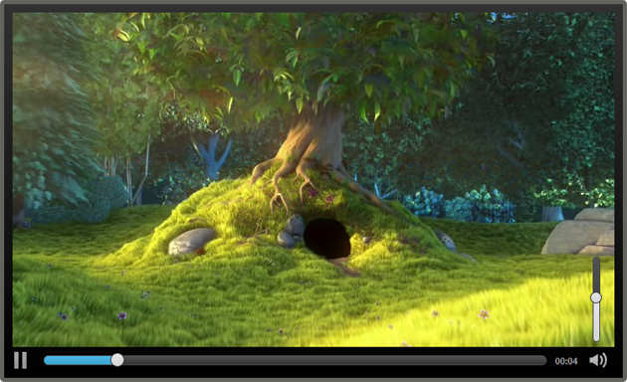
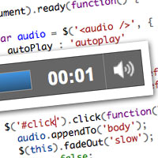
HTML Multimedia: <video> & <audio>
1 - <video> Tag
Used to embed video content in a webpage.
Supports controls like play, pause, volume, fullscreen.
2 - <audio> Tag
Used to embed audio content.
Supports controls like play, pause, volume.
<video src="video.webm"></video>
<audio src="audio.mp3" controls></audio>
controls : show play/pause, volume. Width, height
autoplay : audio /video starts automatically.
loop : audio/ video repeats continuously.
preload="auto" : browser loads the full audio file when the page loads.

Slide 42
HTML Multimedia: <video> & <audio>
<video width="360" height="640" poster="image.jpg" controls>
<source src="video.mp4" type="video/mp4" />
<source src="video.webm" type="video/webm" />
<source src="video.ogv" type="video/ogg" />
Alternative content: a download link, a message, etc.
</video>
<audio controls>
<source src="audio.mp3" type="audio/mpeg" />
<source src="audio.ogg" type="audio/ogg" />
Alternative content: your browser does not support the audio element.
</audio>

Slide 43
HTML5 Document Structure
The <div> tag provide flexible control for applying a style to parts of a document
HTML5 structural elements can be used inside the <div> tag
The <div> tag has no innate sementic meaning besides the logical grouping of the content

Slide 44
LAB 1: Basics of HTML

Slide 45
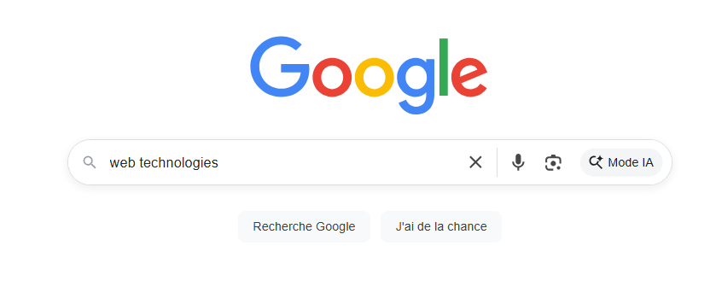
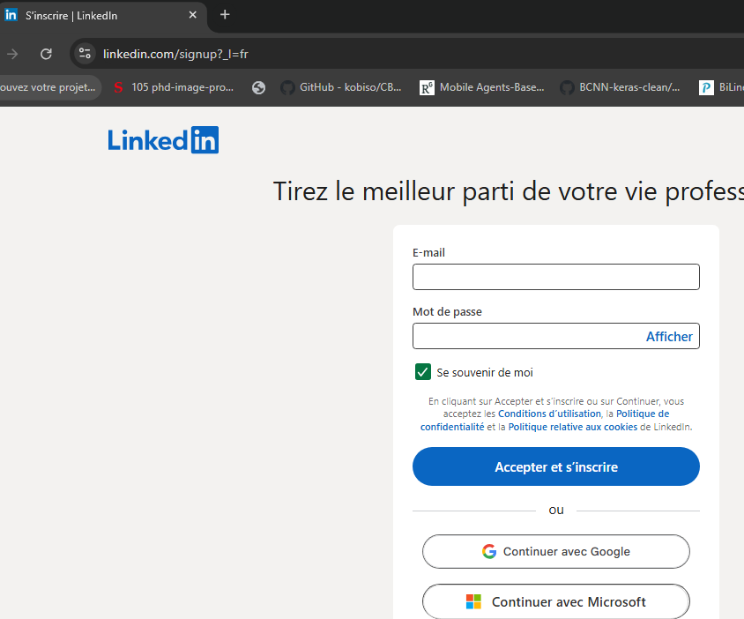

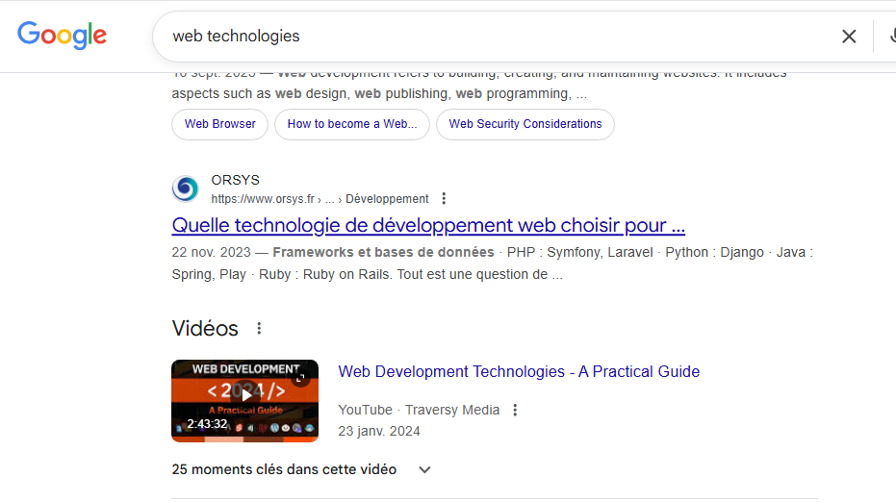
HTML Forms
Google Sever

Slide 46

HTML Forms
A form is an HTML element that allows users to enter and submit data to a server.
A form is inserted into an HTML page using the double <form> tag.
All formatting can be applied to form elements.
Attributes:
action → URL where form data is sent
method → HTTP methodused to send the data using GET or POST.

Slide 47
<form> Tag
Basic elements
Label: Associates text with an input field.
<label for="username">Username:</label>
Input field:
<input type="text" id="username" name="username">

Slide 48
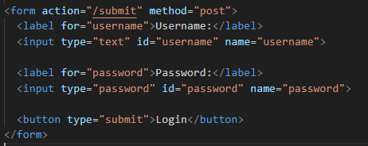
Form Structure (Labels & Inputs)
Label: <label> → Associates text with an input field.
<input> → Creates an interactive field where the user can enter or select data.
Name: name of field.
Size: width of the box reserved for the field.

Slide 49
Form Structure (Labels & Inputs)
MAXLENGTH: maximum length of the text
Name: name of field.
Value: Value of field.
Types: Input types.
→Relationship: All <label> and <input> fields go inside the <form> container

Slide 50
Input Types
text :single-line text
password :hidden text
email :email
input button :clickable button
checkbox :selection box
radio :radio button
color :color picker
date, datetime-local :date/time inputs
file :file upload
hidden :hidden field
image :image button

Slide 51
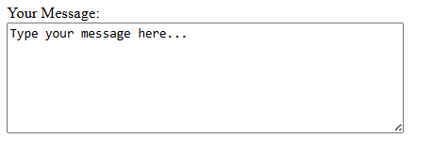

Others form Fields
Text Area
Text Area: <textarea> … </textarea>: multi-line text input

Slide 52


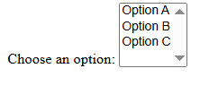
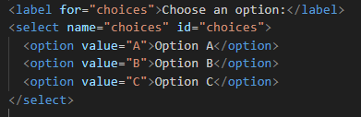
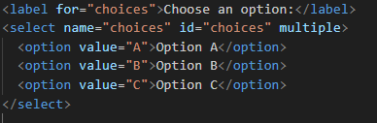

Buttons
Buttons allow actions inside forms:
Select & Option
Dropdown list:
Multiple choices

Slide 53
Useful Input Attributes
autocomplete :browser suggests input
autofocus :automatically focus the Field
checked / selected :pre-select checkboxes, radio buttons, options
disabled / readonly :prevent user input
max, min, step :numerical limits
maxlength, minlength :text length limits
placeholder :hint text
pattern :regex validation

Slide 54
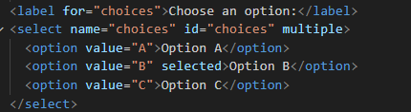
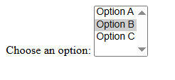
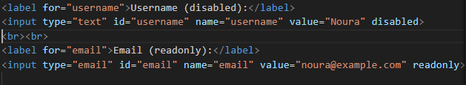

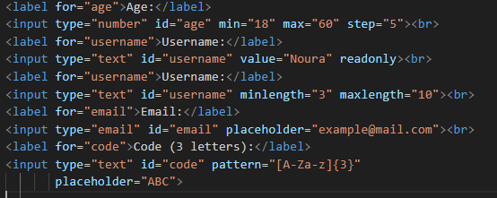
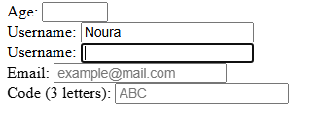
Examples of Attributes
checked/selected
Disabled/readonly
Max/min/step

Slide 55
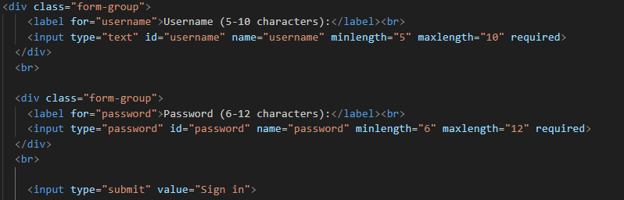
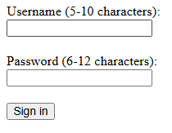

Examples of Attributes
maxlength/minlength
Place holder

Slide 56
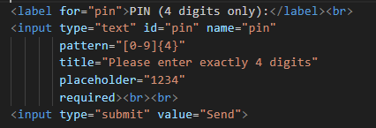
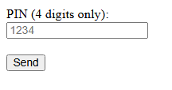
Examples of Attributes
pattern : used to validate the user input against a regular expression .

Slide 57
Conclusion
Proper spacing and indentation make the code more readable.
Always check your code using the W3C Validator s.
Following best practices enhances accessibility, user experience, and SEO.
With Google Analytics and Search Console, you can track visitors and optimize your pages.
The default style is simple; CSS can be used to improve the appearance.

